Slide 1
Memory Management

Slide 2
Memory Management
Is the task carried out by the OS and hardware to accommodate multiple processes in main memory
If only a few processes can be kept in main memory, then much of the time all processes will be waiting for I/O and the CPU will be idle
Hence, memory needs to be allocated efficiently in order to pack as many processes into memory as possible

Slide 3
Level of Storage
There are various levels of computer memory
Registers
Cache
Main Memory
Secondary Memory
Tertially Memory

Slide 4
Memory
Main memory stores data and processes being executed by the cpu
It consists of tiny cells which holds the data and processes
Each cell has an address which identifies its location.
The OS determines how the memory is utilised

Slide 5
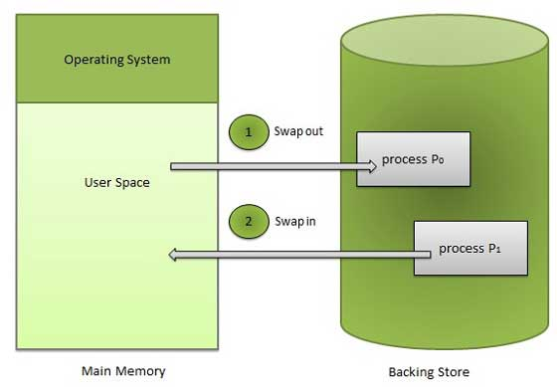

Slide 6
Process Execution Cycle
Fetch – from memory or register
Decode – interpret
Execute – run
Store – return back to memory/register

Slide 7
Logical Vs Physical Address
• Logical address – generated by the CPU; also referred to as virtual address – identifies a process in CPU
• Physical address – Actual address of a cell unit
OS maps logical address in physical address

Slide 8
MEMORY MANAGEMENT FUNCTIONS
1. Keep track of what parts of memory are in use. Ensure efficient memory utilization
2. Allocate memory to processes when needed.
3. Deallocate when processes are done.
4. Swapping, or paging, between main memory and disk, when disk is too small to hold all current processes.

Slide 9
5. Relocation
programmer cannot know where the program will be placed in memory when it is executed
a process may be (often) relocated in main memory due to swapping
memory references in code (for both instructions and data) must be translated to actual physical memory address

Slide 10
6. Protection
processes should not be able to reference memory locations in another process without permission
impossible to check addresses at compile time in programs since the program could be relocated
address references must be checked at run time by hardware

Slide 11
Memory management provides protection by using two registers, a base register and a limit register. The base register holds the smallest legal physical memory address and the limit register specifies the size of the range. For example, if the base register holds 300000 and the limit register is 1209000, then the program can legally access all addresses from 300000 through 411999.

Slide 12
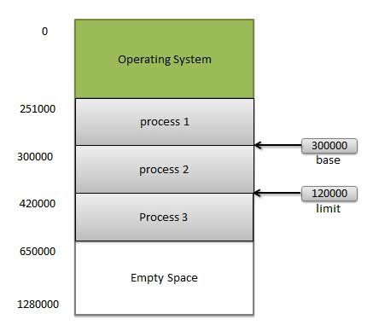

Slide 13
7. Sharing
must allow several processes to access a common portion of main memory without compromising protection
cooperating processes may need to share access to the same data structure
better to allow each process to access the same copy of the program rather than have their own separate copy

Slide 14
8. Logical Organization
users write programs in modules with different characteristics
instruction modules are execute-only
data modules are either read-only or read/write
some modules are private others are public
To effectively deal with user programs, the OS and hardware should support a basic form of module to provide the required protection and sharing

Slide 15
9. Physical Organization
secondary memory is the long term store for programs and data while main memory holds program and data currently in use
moving information between these two levels of memory is a major concern of memory management (OS)
it is highly inefficient to leave this responsibility to the application programmer

Slide 16
Fragmentation
As processes are loaded and removed from memory, the free memory space is broken into little pieces. It happens after sometimes that processes can not be allocated to memory blocks considering their small size and memory blocks remains unused. This problem is known as Fragmentation.

Slide 17
External fragmentation
Total memory space is enough to satisfy a request or to reside a process in it, but it is not contiguous so it can not be used.
Internal fragmentation
Memory block assigned to process is bigger. Some portion of memory is left unused as it can not be used by another process.

Slide 18
Evolution Memory Management Schemes
Memory management schemes aims to accommodate as many processes as possible
An executing process must be loaded in main memory
The following memory management techniques have been used in OS over the years.
No management
fixed partitioning
dynamic partitioning
Virtual Memory
simple paging
simple segmentation

Slide 19
Fixed Partitioning
Partition main memory into a set of non overlapping regions called partitions
Partitions can be of equal or unequal sizes

Slide 20
Fixed Partitioning
any process whose size is less than or equal to a partition size can be loaded into the partition
if all partitions are occupied, the operating system can swap a process out of a partition

Slide 21
Algorithms for allocating memory .
1. FIRST FIT - allocates the first hole found that is large enough - fast (as little searching as possible).
2. NEXT FIT - almost the same as First Fit except that it keeps track of where it last allocated space and starts from there instead of from the beginning - slightly better performance.
3. BEST FIT - searches the entire list looking for a hole that is closest to the size needed by the process - slow - also does not improve resource utilization because it tends to leave many very small ( and therefore useless) holes.
4. WORST FIT - the opposite of Best Fit - chooses the largest available hole and breaks off a hole that islarge enouggh to be useful (I.e. hold another process) - in practice has not been shown to work better than others.

Slide 22
Dynamic Partitioning
Partitions are of variable length and number
Each process is allocated exactly as much memory as it requires
Used in IBM’s OS/MVT (Multiprogramming with a Variable number of Tasks)

Slide 23
Dynamic Partitioning: an example
A hole of 64K is left after loading 3 processes: not enough room for another process
Eventually each process is blocked. The OS swaps out process 2 to bring in process 4

Slide 24
Dynamic Partitioning: an example
another hole of 96K is created
Eventually each process is blocked. The OS swaps out process 1 to bring in again process 2 and another hole of 96K is created...
Compaction would produce a single hole of 256K

Slide 25
Virtual Memory
The above schemes only make use of available memory.
Virtual memory aims to make memory bigger than it really is by making use of secondary storage as an extension of main memory
Implementation - paging, segmentation

Slide 26
Simple Paging
Main memory is partition into equal fixed-sized chunks (of relatively small size) known as page frames
Each process is also divided into chunks of the same size called pages
The process pages can thus be assigned to the available frames (or page frames)
Consequence: a process does not need to occupy a contiguous portion of memory

Slide 27
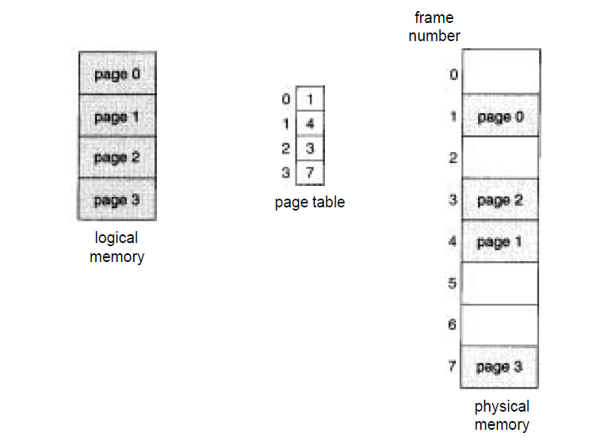

Slide 28
In a paging system, each process contains active pages in memory(physical memory) and inactive pages in logical memory.
Inactive pages are swapped into memory when required. Similarly, active pages are swapped out (replaced) once executed.

Slide 29
Page Replacement Algorithms
Determine the order in which pages are swapped out from memory.
Replacement takes the following approach. If no frame is free, we find one
that is not currently being used and free it.
First In First Out Algorithm: when a new page must be brought in, replace the page that has been in memory the longest. Seldom used: even though a page has been in memory a long time, it may still be needed frequently.
Second Chance Algorithm: this is a modification of FIFO. The Referenced bit of the page that has been in memory longest is checked before that page is automatically replaced. If the R bit has been set to 1, that page must have been referenced during the previous clock cycle. That page is placed at the rear of the list and its R bit is reset to zero. A variation of this algorithm, the ‘clock’ algorithm keeps a pointer to the oldest page using a circular list. This saves the time used in the Second Chance Algorithm moving pages in the list

Slide 30
Not Recently Used Algorithm (NRU) is a practical algorithm that makes use of the bits ‘Referenced’ and ‘Modified’. These bits are updated on every memory reference and must be set by the hardware. On every clock cycle the operating system can clear the R bit. This distinguishes those pages that have been referenced most recently from those that have not been referenced during this clock cycle. The combinations are:
(0) not referenced and not modified
(1) not referenced, modified
(2) referenced, not modified
(3) referenced, modified
NRU randomly chooses a page from the lowest class to remove

Slide 31
Least Recently Used Algorithm (LRU) - keep track of each memory reference made to each page by some sort of counter or table. Choose a page that has been unused for a long time to be replaced. This requires a great deal of overhead and/or special hardware and is not used in practice. It is simulated by similar algorithms:
Not Frequently Used - keeps a counter for each page and at each clock interrupt, if the R bit for that page is 1, the counter is incremented. The page with the smallest counter is chosen for replacement. What is the problem with this?
A page with a high counter may have been referenced a lot in one phase of the process, but is no longer used. This page will be overlooked, while another page with a lower counter but still being used is replaced.

Slide 32
Aging -a modification of NFU that simulates LRU very well.
The counters are shifted right 1 bit before the R bit is added in.
Also, the R bit is added to the leftmost rather than the rightmost
bit. When a page fault occurs, the page with the lowest counter is
still the page chosen to be removed. However, a page that has not
been referenced for a while will not be chosen. It would have
many leading zeros, making its counter value smaller than a page
that was recently referenced.

Slide 33
Page Fault
A page fault is said to occur in a page referenced is not available in memory.
When a page fault occurs, the current process is halted and transfer into memory is initiated

Slide 34
How is a page fault actually handled?
1. Trap to the operating system ( also called page fault interrupt).
2. Save the user registers and process state; i.e. process goes into waiting state.
3. Determine that the interrupt was a page fault.
4. Check that the page reference was legal and, if so, determine the location of the page on the disk.
5. Issue a read from the disk to a free frame and wait in a queue for this device until the read request is serviced. After the device seek completes, the disk controller begins the transfer of the page to the frame.
6. While waiting, allocate the CPU to some other user.
7. Interrupt from the disk occurs when the I/O is complete. Must determine that the interrupt was from the disk.
8. Correct the page table /other tables to show that the desired page is now in memory.
9. Take process out of waiting queue and put in ready queue to wait for the CPU again.
10. Restore the user registers, process state and new page table, then resume the interrupted instruction.

Slide 35
Simple Segmentation
Each program is subdivided into blocks of non-equal size called segments
When a process gets loaded into main memory, its different segments can be located anywhere
Each segment is fully packed with instructs/data: no internal fragmentation
There is external fragmentation; it is reduced when using small segments

Slide 37
Thrashing
CPU utilization increases with increase in degree of multiprogramming.
However, beyond a certain limit of multiprogramming CPU utilization suddenly starts to decrease.
Reason - Thrashing

Slide 40
Simple Segmentation
In contrast with paging, segmentation is visible to the programmer
provided as a convenience to organize logically programs (ex: data in one segment, code in another segment)
must be aware of segment size limit
The OS maintains a segment table for each process. Each entry contains:
the starting physical addresses of that segment.
the length of that segment (for protection)

Slide 41
Working Set Theory
The set of pages that a process is currently using is called its ‘working set’. If the entire working set is in memory, there will be no page faults.
If not, each read of a page from disk may take 10 milliseconds (.010 of a second). Compare this to the time it takes to execute an instruction: a few nanoseconds (.000000002 of a second). If a program has page faults every few instructions, it is said to be ‘thrashing’. Thrashing is happening when a process spends more time paging than executing.

Slide 42
Page Replacement Algorithms (cont)
The Working Set Algorithm keeps track of a process’ ‘working set’ and makes sure it is in memory before letting the process run. Since processes are frequently swapped to disk, to let other processes have CPU time, pure demand paging would cause so many page faults, the system would be too slow.
Ex. A program using a loop that occupies 2 pages and data from 4 pages, may reference all 6 pages every 1000 instructions. A reference to any other page may be a million instructions earlier.

Slide 43
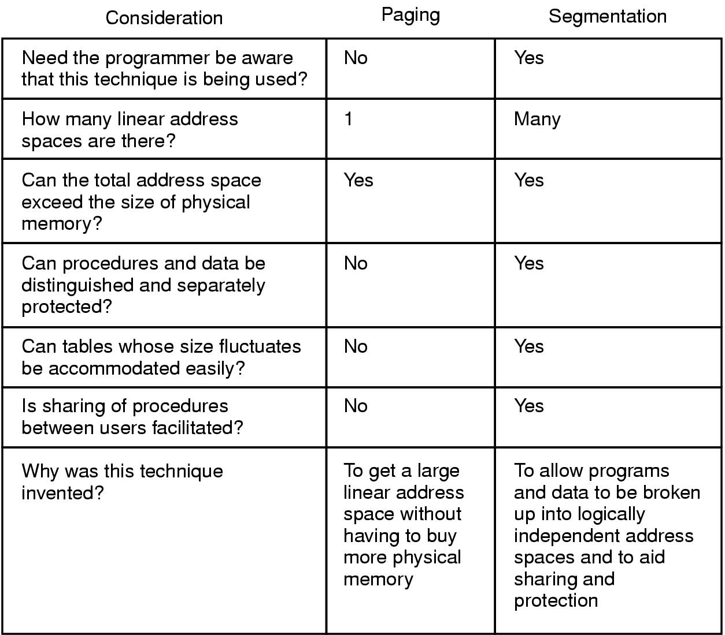
Comparison of paging and segmentation

Slide 44
Thrashing
A process is thrashing if it is spending more time paging than executing.
As the degree of multiprogramming increases, CPU utilization also increases, although more slowly,until a maximum is reached.
If the degree of multiprogramming is increased even further, thrashing sets in and CPU utilization drops sharply

Slide 45
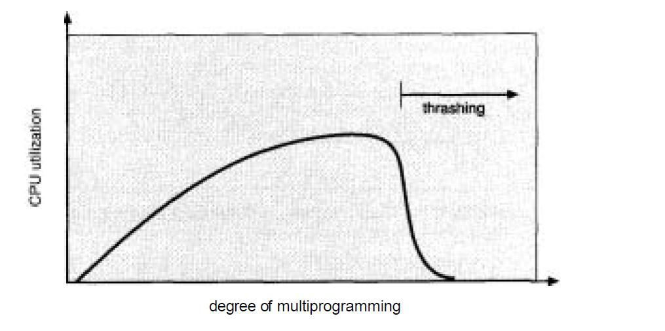

Slide 46
The more the number of processes in memory, the less the number of pages for each process.
The likelihood of a page fault occuring becomes very high and the missing page has to be swapped in.
System spends more time paging than doing actual work
This high paging activity is called thrashing.

Slide 47
Working Set Theory
To avoid thrashing, a process is required to have a minimum number of pages in memory – Working Set.
If the number of frames allocated to a low-priority process falls below the minimum number required by the computer architecture, we must suspend that process' execution.
We should then page out its remaining pages, freeing all its allocated frames.

Slide 48
THE END

